Slide 1
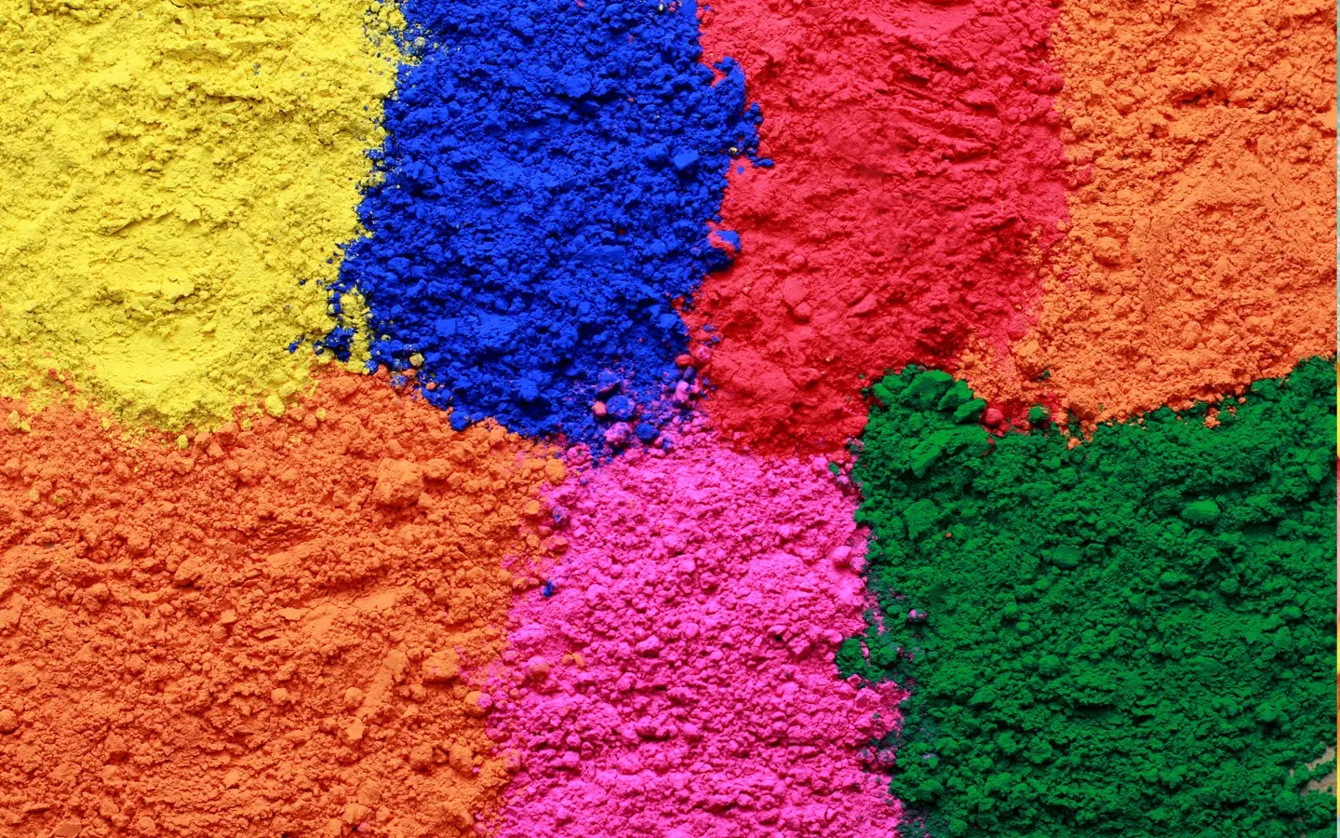
Decision Tree
Sukanta Ghosh
Asst. Professor

Slide 2
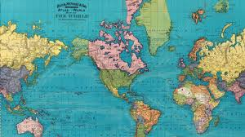

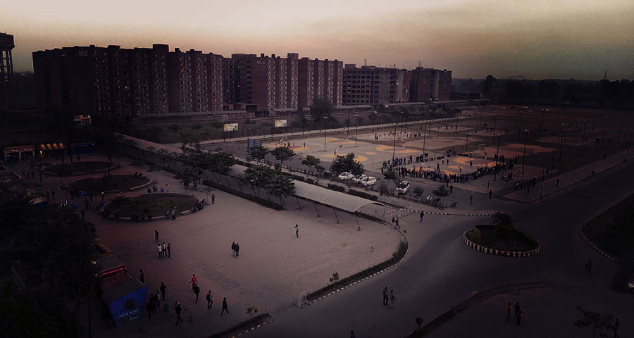
What we are going to learn?
What is decision Tree?
Terms related to Decision Tree
Different types of splitting criteria
Pros/Cons of Decision Tree
Python implementation of Decision Tree

Slide 3
Decision Tree Algorithm
Supervised learning algorithms
Used to solve both regression and classification.
More useful for classification.
Goal is to create a training model that can use to predict the class or value of the target variable by learning simple decision rules inferred from prior data(training data).
Decision tree is a tree structured classifier.
Tree has node.
Two types of nodes:
Decision Nodes: Specify a choice/test, based on which you choose your movement.
Leaf Nodes: Indicate classification/value of the example

Slide 4
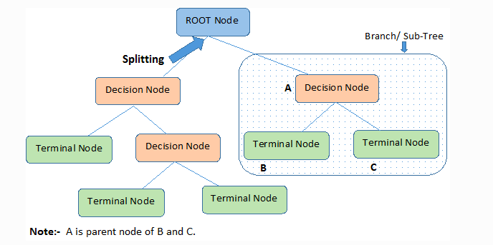
Nodes of a Tree

Slide 5
Types of Decision Trees
Types of decision trees are based on the type of target variable we have. It can be of two types:
Categorical Variable Decision Tree: Decision Tree which has a categorical target variable then it called a Categorical variable decision tree.
Predict whether a customer will pay his renewal premium with an insurance company (yes/ no).
Continuous Variable Decision Tree: Decision Tree has a continuous target variable then it is called Continuous Variable Decision Tree.
Predict customer income based on occupation, product, and various other variables.

Slide 6
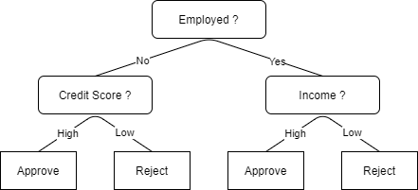
Lets take an example: Loan Approval System

Slide 7
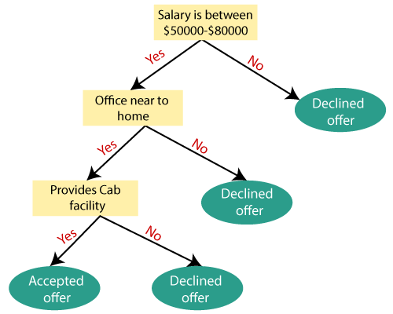
Lets take an example: Job Offer Decision

Slide 8
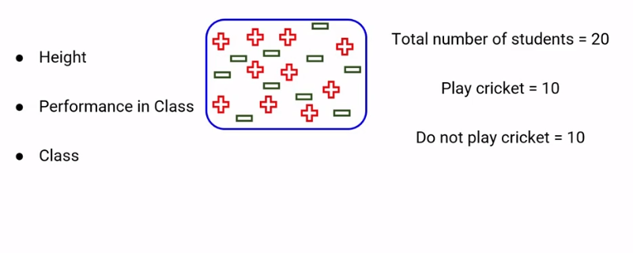
Decision Tree Explanation

Slide 9
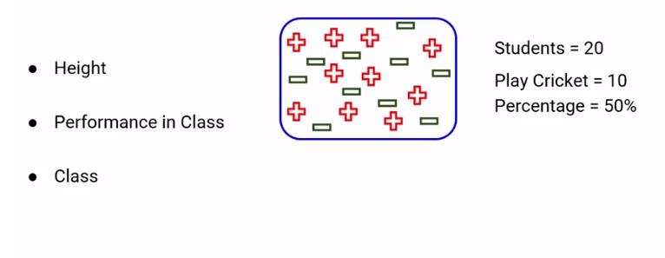
Decision Tree Explanation

Slide 10
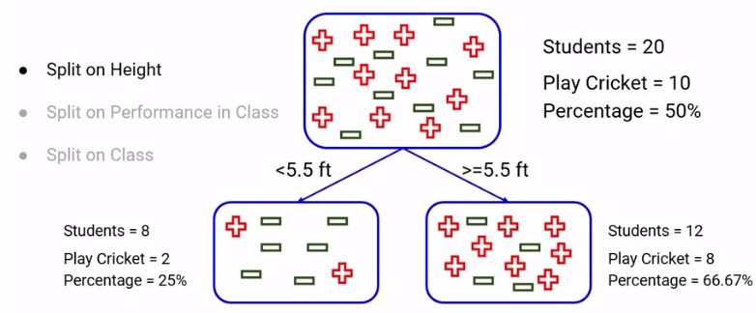
Decision Tree Explanation

Slide 11
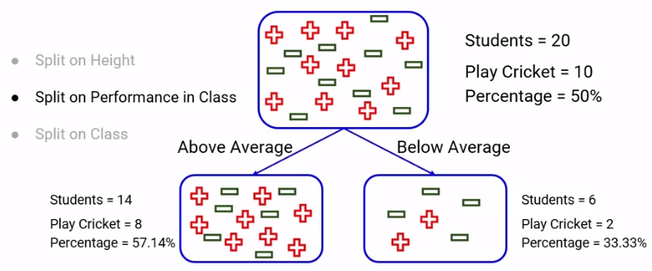
Decision Tree Explanation

Slide 12
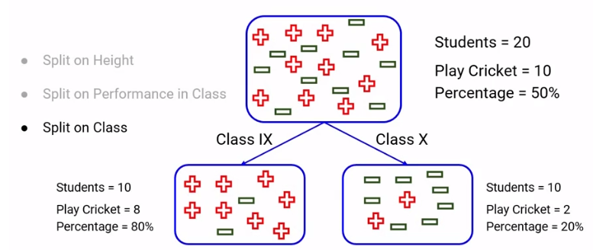
Decision Tree Explanation

Slide 13
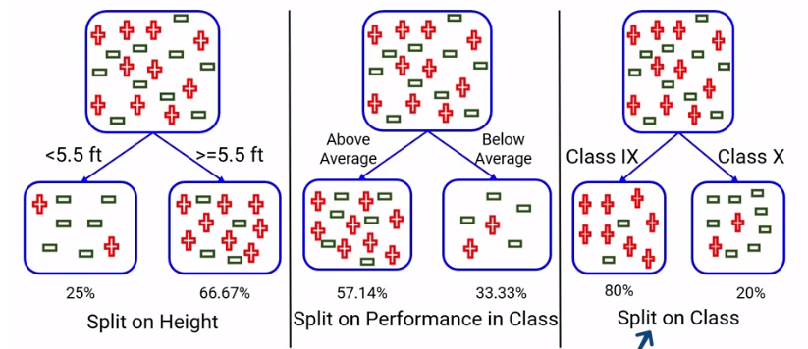
Which one will you choose and why?

Slide 14
Question
What is the basic idea behind choosing the best split in the data?
Resultant nodes should be as heterogeneous as possible
Resultant nodes should be as Homogeneous as possible
The resultant nodes should have the exact same number of observations

Slide 15
Question
What is the basic idea behind choosing the best split in the data?
Resultant nodes should be as heterogeneous as possible
Resultant nodes should be as Homogeneous as possible
The resultant nodes should have the exact same number of observations

Slide 16
Question
Only continuous variables can be used to split the data in decision trees. True or false?
True
False

Slide 17
Question
Only continuous variables can be used to split the data in decision trees. True or false?
True
False

Slide 18
What would be the Ideal Split ? Any guesses !

Slide 19
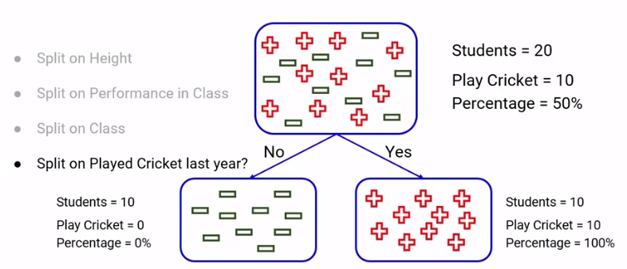
Ideal Case

Slide 20
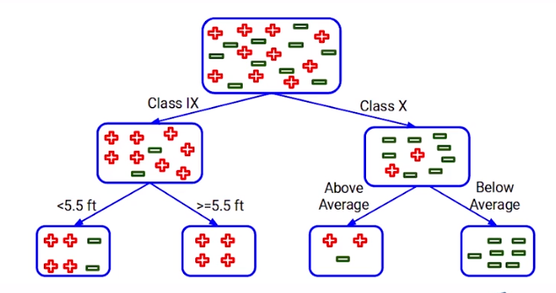
Multiple Splits

Slide 21
Lets freeze the mind
How do we decide which split is better?
Which splits should be first or which split should be second and so on?
What is the sequence the split should be made?

Slide 22
Need to defrost now
There are various techniques to decide the purity of the node, based on this we decide every split.

Slide 23
Question
What does an ideal pure node have?
Choose only ONE best answer.
Equal distribution of all classes
100% of one class and 0 of other classes
Distribution of classes does not decide the purity

Slide 24
Question
What does an ideal pure node have?
Choose only ONE best answer.
Equal distribution of all classes
100% of one class and 0 of other classes
Distribution of classes does not decide the purity

Slide 25
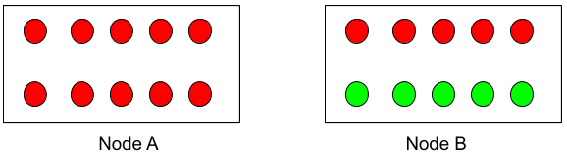
Question
Which of the following is a more pure node?
Choose only ONE best answer.
Node A
Node B

Slide 26
Question
Which of the following is a more pure node?
Choose only ONE best answer.
Node A
Node B

Slide 27
Terminologies Related to Decision Trees

Slide 28
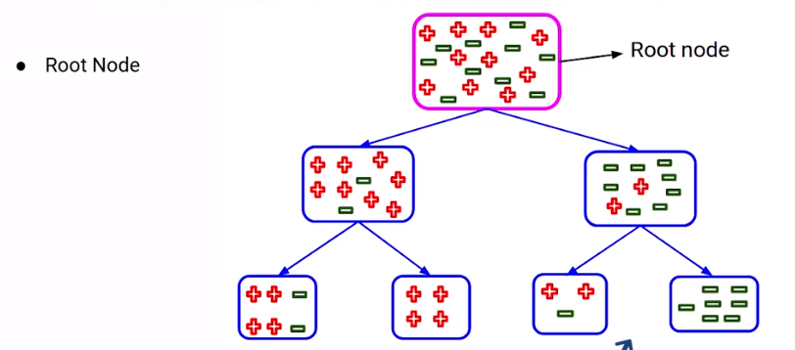
Terminologies Related to Decision Trees

Slide 29
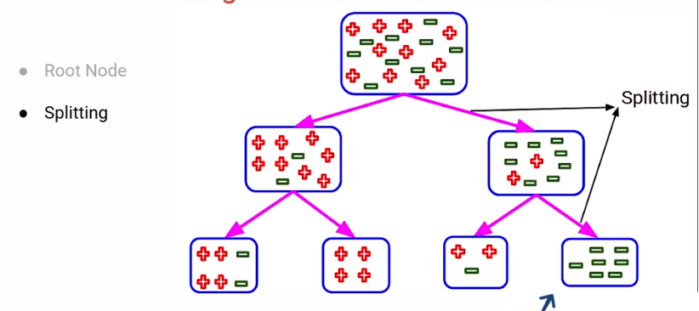

Slide 30
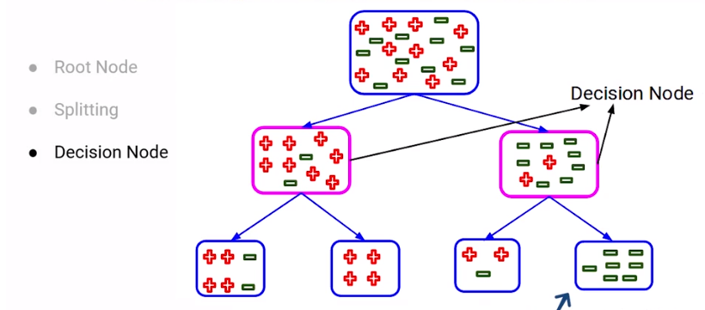

Slide 31
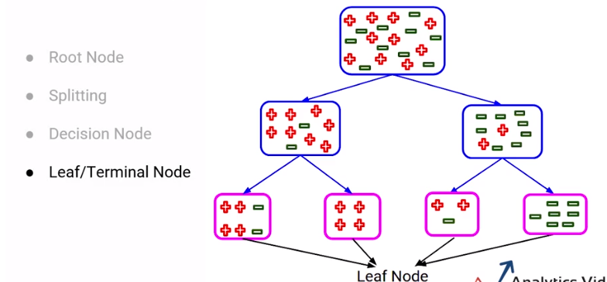

Slide 32
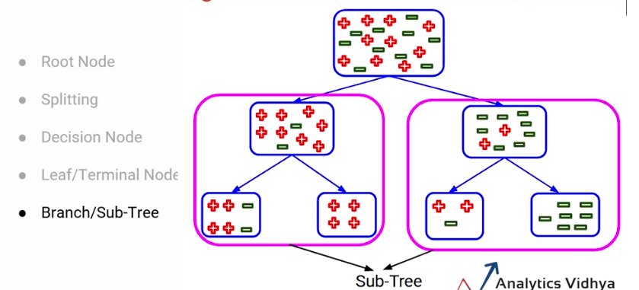

Slide 33
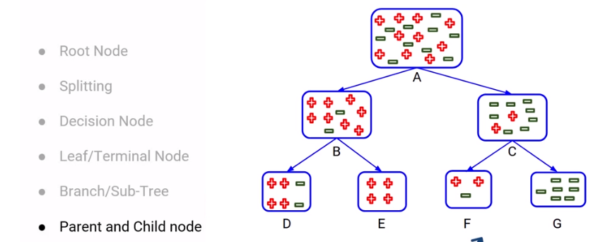

Slide 34
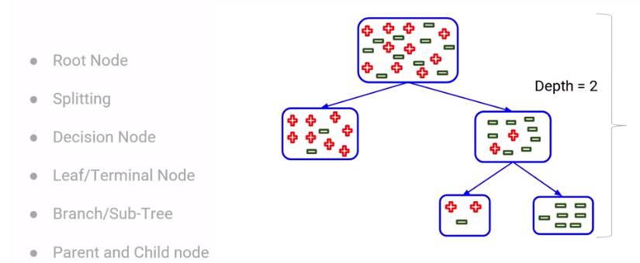

Slide 35
Select the Best Split Point

Slide 36
How to Select the Best Split Point in Decision Trees
Decision tree splits the nodes on all the variables.
Selects the splits which results in most homogeneous sub-nodes.

Slide 37
Node splitting in decision tree
There are multiple ways of doing this, which can be broadly divided into two categories based on the type of target variable:
Continuous Target Variable
Reduction in Variance
Categorical Target Variable
Gini Impurity
Information Gain
Chi-Square

Slide 38
GINI Impurity

Slide 39
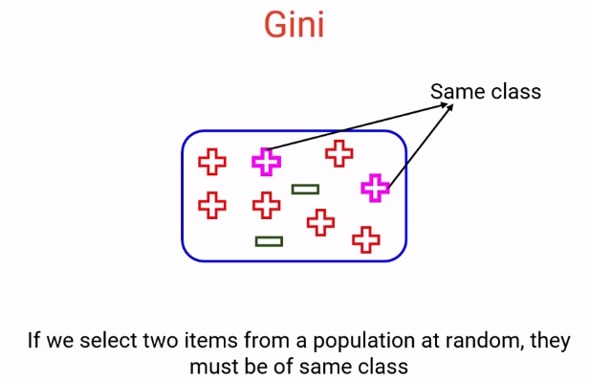
GINI Impurity
GINI Impurity = 1 – Gini

Slide 40
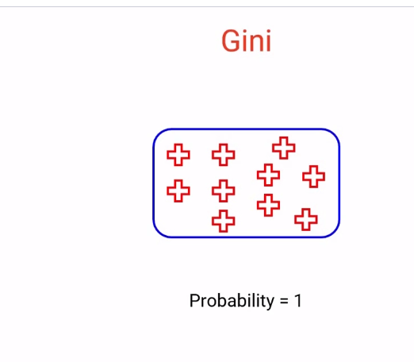
Gini ranges from 0 to 1 as it is probability. More value of node means higher purity. Less value means less purity.

Slide 41
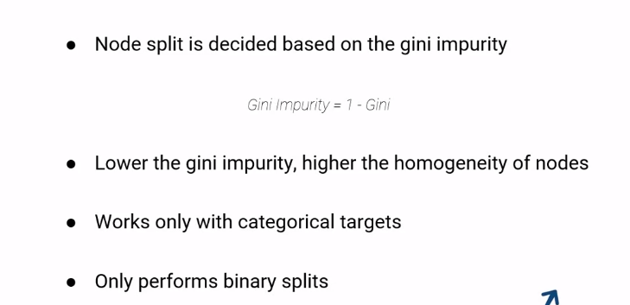
Properties of Gini Impurity

Slide 42
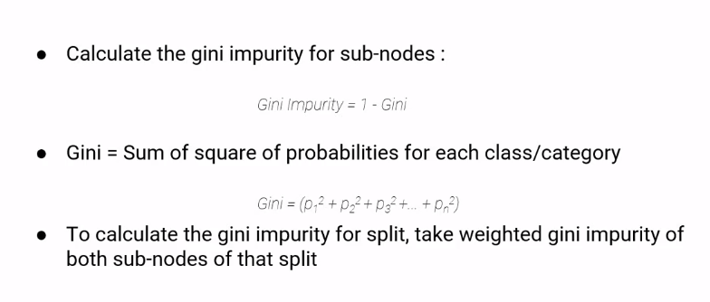
Steps to calculate Gini impurity

Slide 43
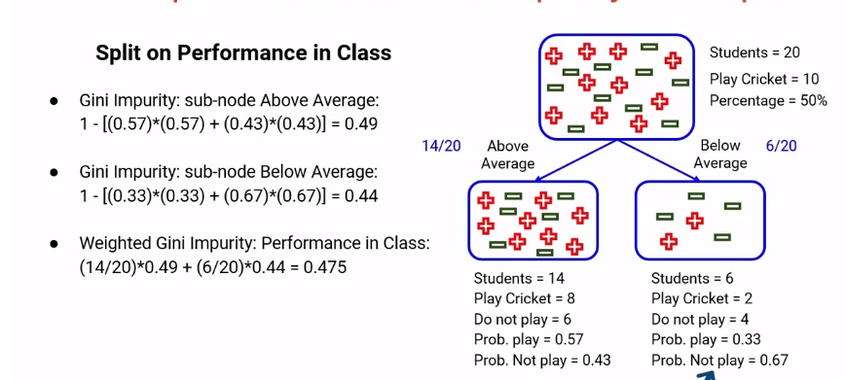
Steps to calculate Gini impurity

Slide 44
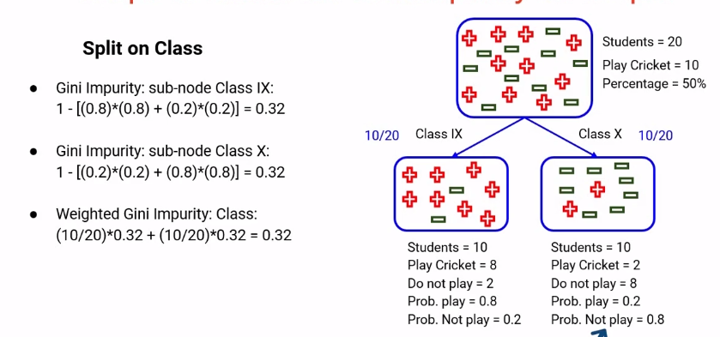
Steps to calculate Gini impurity

Slide 45
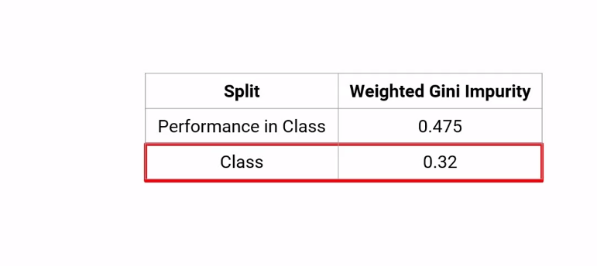
Steps to calculate Gini impurity

Slide 46
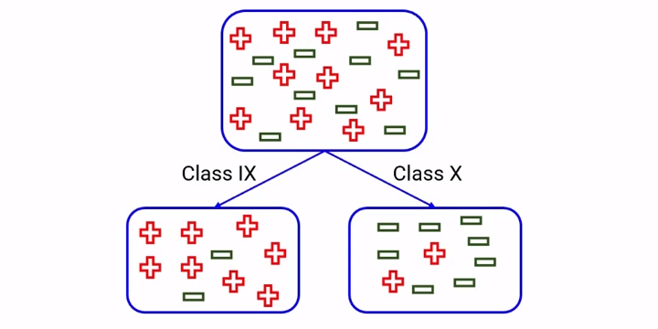

Slide 47
Questions
Gini can be used for multiclass classification problems. True or false?
Choose only ONE best answer.
True
False

Slide 48
Answer
Gini can be used for multiclass classification problems. True or false?
Choose only ONE best answer.
True
False

Slide 49
Question
What does Gini value of 1 represent?
The nodes are homogeneous
The nodes are heterogeneous

Slide 50
Answer
What does Gini value of 1 represent?
The nodes are homogeneous
The nodes are heterogeneous

Slide 51
Question
The value of Gini Impurity should be as high as possible in any given split. True or false?
True
False

Slide 52
Answer
The value of Gini Impurity should be as high as possible in any given split. True or false?
True
False

Slide 53
Create a decision tree using GINI Impurity method.
Day | Weather | Temperature | Humidity | Wind | Play?
1 | Sunny | Hot | High | Weak | No
2 | Cloudy | Hot | High | Weak | Yes
3 | Sunny | Mild | Normal | Strong | Yes
4 | Cloudy | Mild | High | Strong | Yes
5 | Rainy | Mild | High | Strong | No
6 | Rainy | Cool | Normal | Strong | No
7 | Rainy | Mild | High | Weak | Yes
8 | Sunny | Hot | High | Strong | No
9 | Cloudy | Hot | Normal | Weak | Yes
10 | Rainy | Mild | High | Strong | No

Slide 54
Create a decision tree using GINI Impurity method.
A property owner is faced with a choice of:
(a) A large-scale investment (A) to improve her flats. This could produce a substantial pay-off in terms of increased revenue net of costs but will require an investment of £1,400,000. After extensive market research it is considered that there is a 40% chance that a pay-off of £2,500,000 will be obtained, but there is a 60% chance that it will be only £800,000.
(b) A smaller scale project (B) to re-decorate her premises. At £500,000 this is less costly but will produce a lower pay-off. Research data suggests a 30% chance of a gain of £1,000,000 but a 70% chance of it being only £500,000.
(c) Continuing the present operation without change (C). It will cost nothing, but neither will it produce any pay-off. Clients will be unhappy and it will become harder and harder to rent the flats out when they become free.
How will a decision tree help the taking of the decision?

Slide 55
Chi-Square Method

Slide 56
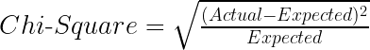
Chi-Square
Chi-square is another method of splitting nodes in a decision tree for datasets having categorical target values.
It can make two or more than two splits.
It works on the statistical significance of differences between the parent node and child nodes.
Properties of Chi-Square:
Works only with categorical variables.
Higher the Chi-Square value, higher the homogeneity of node.

Slide 57
Steps to split a decision tree using Chi-Square
For each split, individually calculate the Chi-Square value of each child node by taking the sum of Chi-Square values for each class in a node
Calculate the Chi-Square value of each split as the sum of Chi-Square values for all the child nodes
Select the split with higher Chi-Square value
Until you achieve homogeneous nodes, repeat steps 1-3

Slide 58
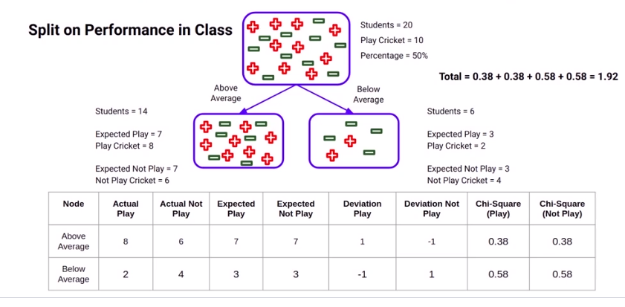
Steps to calculate Chi-Square

Slide 59
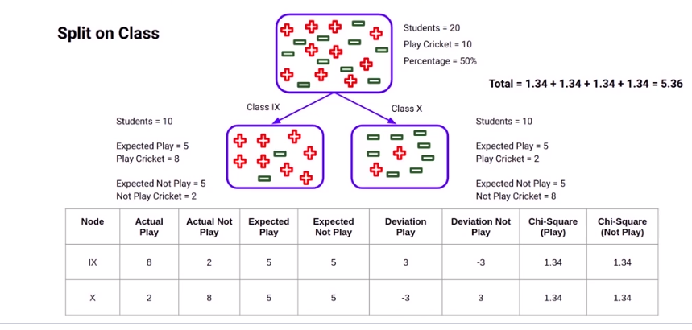
Steps to calculate Chi-Square

Slide 60
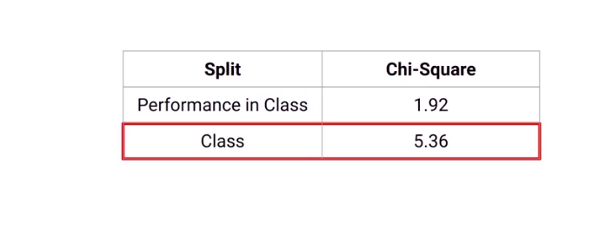
Steps to calculate Chi-Square

Slide 61
Question
What does a high value of Chi-square indicate?
Node follows the distribution of parent node
Node distribution is very different from parent node
Node is more homogeneous than the parent
Node is less homogeneous than the parent
I only
I and III
II and III
IV only

Slide 62
Answer
What does a high value of Chi-square indicate?
Node follows the distribution of parent node
Node distribution is very different from parent node
Node is more homogeneous than the parent
Node is less homogeneous than the parent
I only
I and III
II and III
IV only

Slide 63
Question
Chi-square checks for the statistical significance of the similarity between the child node and the parent node. True or false?
True
False

Slide 64
Answer
Chi-square checks for the statistical significance of the similarity between the child node and the parent node. True or false?
True
False

Slide 65
Question
Which of the following is incorrect about Chi-Square?
Works only with the Categorical Target variable
Can only perform binary split
Higher the chi-square value, higher the homogeneity

Slide 66
Answer
Which of the following is incorrect about Chi-Square?
Works only with the Categorical Target variable
Can only perform binary split
Higher the chi-square value, higher the homogeneity

Slide 67
Create a decision tree using Chi-Square method.
Day | Weather | Temperature | Humidity | Wind | Play?
1 | Sunny | Hot | High | Weak | No
2 | Cloudy | Hot | High | Weak | Yes
3 | Sunny | Mild | Normal | Strong | Yes
4 | Cloudy | Mild | High | Strong | Yes
5 | Rainy | Mild | High | Strong | No
6 | Rainy | Cool | Normal | Strong | No
7 | Rainy | Mild | High | Weak | Yes
8 | Sunny | Hot | High | Strong | No
9 | Cloudy | Hot | Normal | Weak | Yes
10 | Rainy | Mild | High | Strong | No

Slide 68
Create a decision tree using Chi-Square method.
A property owner is faced with a choice of:
(a) A large-scale investment (A) to improve her flats. This could produce a substantial pay-off in terms of increased revenue net of costs but will require an investment of £1,400,000. After extensive market research it is considered that there is a 40% chance that a pay-off of £2,500,000 will be obtained, but there is a 60% chance that it will be only £800,000.
(b) A smaller scale project (B) to re-decorate her premises. At £500,000 this is less costly but will produce a lower pay-off. Research data suggests a 30% chance of a gain of £1,000,000 but a 70% chance of it being only £500,000.
(c) Continuing the present operation without change (C). It will cost nothing, but neither will it produce any pay-off. Clients will be unhappy and it will become harder and harder to rent the flats out when they become free.
How will a decision tree help the taking of the decision?

Slide 69
Information Gain Method

Slide 70
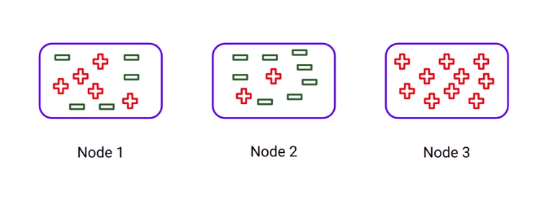
Information Gain

Slide 71
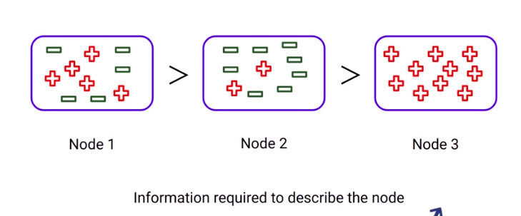
Information Gain

Slide 72
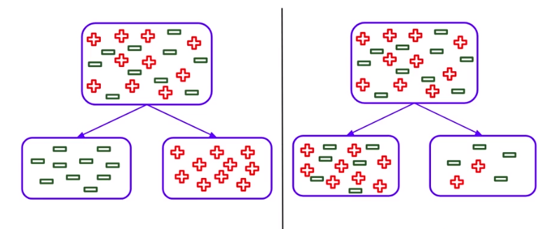
Information Gain

Slide 73
Information Gain
Information Gain is used for splitting the nodes when the target variable is categorical.
It works on the concept of the entropy and is given by:
Entropy is used for calculating the purity of a node.
Lower the value of entropy, higher is the purity of the node.
The entropy of a homogeneous node is zero.
Since we subtract entropy from 1, the Information Gain is higher for the purer nodes with a maximum value of 1.

Slide 74
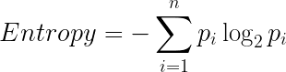
Information Gain
The formula for calculating the entropy:

Slide 75
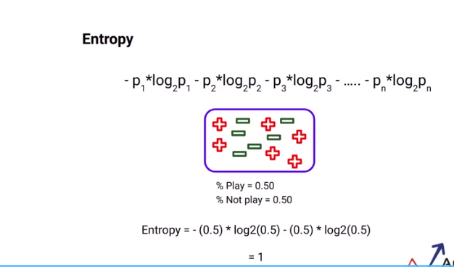
Entropy

Slide 76
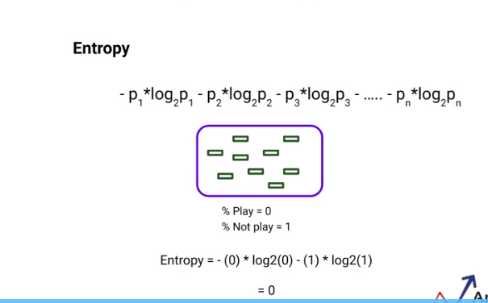
Entropy

Slide 77
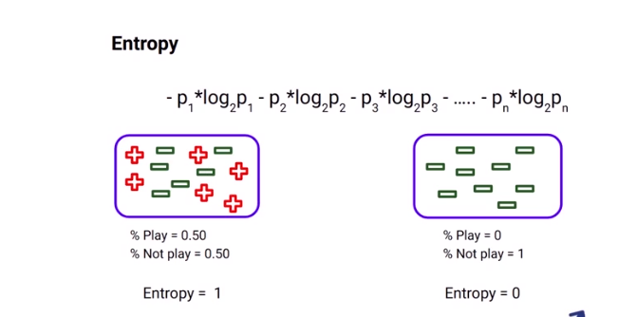
Entropy

Slide 78
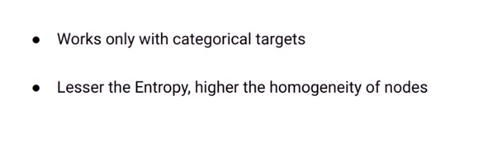
Property of Entropy

Slide 79
Steps to split a decision tree using Information Gain
For each split, individually calculate the entropy of each child node
Calculate the entropy of each split as the weighted average entropy of child nodes
Select the split with the lowest entropy or highest information gain
Until you achieve homogeneous nodes, repeat steps 1-3

Slide 80
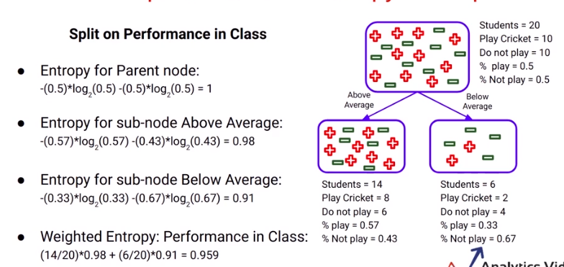
Calculation of Entropy

Slide 81
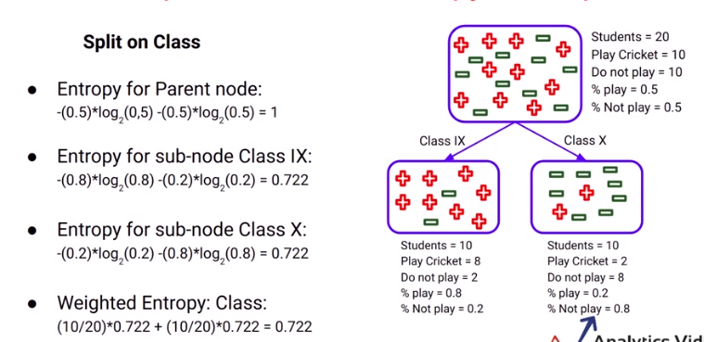
Calculation of Entropy

Slide 82
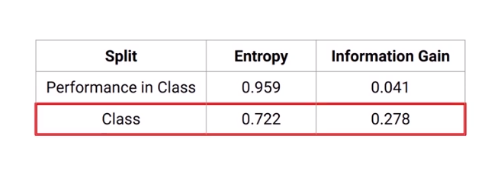
Choosing the best split

Slide 83
Question
After splitting, Information Gain is more than that of the parent node. What does this mean?
Parent node is more homogeneous
Child nodes are more homogeneous
Parent node and child node have the same distribution

Slide 84
Answer
After splitting, Information Gain is more than that of the parent node. What does this mean?
Parent node is more homogeneous
Child nodes are more homogeneous
Parent node and child node have the same distribution

Slide 85
Create a decision tree using Information gain method.
Day | Weather | Temperature | Humidity | Wind | Play?
1 | Sunny | Hot | High | Weak | No
2 | Cloudy | Hot | High | Weak | Yes
3 | Sunny | Mild | Normal | Strong | Yes
4 | Cloudy | Mild | High | Strong | Yes
5 | Rainy | Mild | High | Strong | No
6 | Rainy | Cool | Normal | Strong | No
7 | Rainy | Mild | High | Weak | Yes
8 | Sunny | Hot | High | Strong | No
9 | Cloudy | Hot | Normal | Weak | Yes
10 | Rainy | Mild | High | Strong | No

Slide 86
Create a decision tree using Information gain method.
A property owner is faced with a choice of:
(a) A large-scale investment (A) to improve her flats. This could produce a substantial pay-off in terms of increased revenue net of costs but will require an investment of £1,400,000. After extensive market research it is considered that there is a 40% chance that a pay-off of £2,500,000 will be obtained, but there is a 60% chance that it will be only £800,000.
(b) A smaller scale project (B) to re-decorate her premises. At £500,000 this is less costly but will produce a lower pay-off. Research data suggests a 30% chance of a gain of £1,000,000 but a 70% chance of it being only £500,000.
(c) Continuing the present operation without change (C). It will cost nothing, but neither will it produce any pay-off. Clients will be unhappy and it will become harder and harder to rent the flats out when they become free.
How will a decision tree help the taking of the decision?

Slide 87
Variance Method

Slide 88
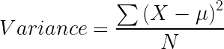
Variance
Reduction in Variance is a method for splitting the node used when the target variable is continuous, i.e., regression problems.
It is so-called because it uses variance as a measure for deciding the feature on which node is split into child nodes.
Variance is used for calculating the homogeneity of a node.
If a node is entirely homogeneous, then the variance is zero.

Slide 89
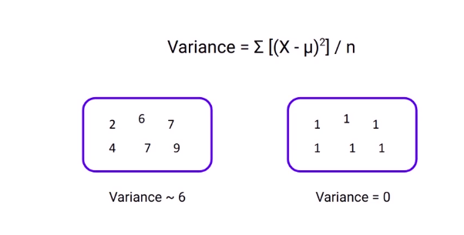
Variance

Slide 90
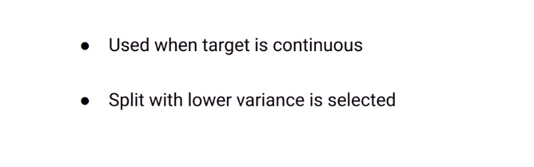
Properties of variance

Slide 91
Steps to split a decision tree using reduction in variance
For each split, individually calculate the variance of each child node
Calculate the variance of each split as the weighted average variance of child nodes
Select the split with the lowest variance
Perform steps 1-3 until completely homogeneous nodes are achieved

Slide 92
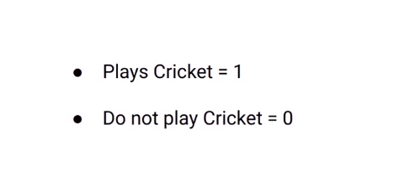
Steps to calculate the variance

Slide 93
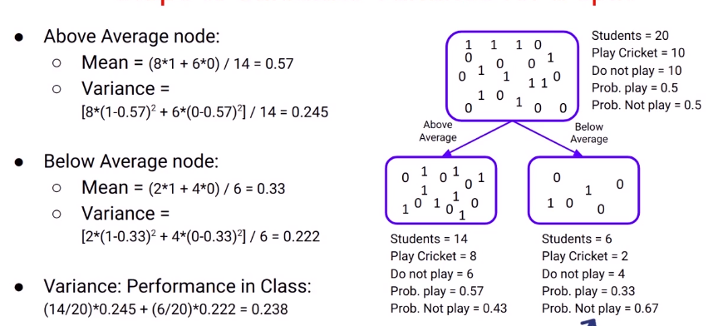
Steps to calculate the variance

Slide 94

Steps to calculate the variance

Slide 95

Steps to calculate the variance

Slide 96

Steps to calculate the variance

Slide 97
Question
Let's say you are asked to work on a problem to predict the future sales of a product in a store and decided to use a decision tree model. Which algorithm should be used for splitting?
Gini
Chi-square
Reduction in variance
Information Gain

Slide 98
Question
Let's say you are asked to work on a problem to predict the future sales of a product in a store and decided to use a decision tree model. Which algorithm should be used for splitting?
Gini
Chi-square
Reduction in variance
Information Gain

Slide 99




Thank You
Sukanta Ghosh
+91-8699583576
Sukanta.19539@lpu.co.in
www.lpu.in

